Slide 1




Multimodal Teacher Forcing for Reconstructing Nonlinear Dynamical Systems
Manuel Brenner¹², Georgia Koppe*¹⁴, Daniel Durstewitz*¹²³
*Equal contribution ¹Dept. of Theoretical Neuroscience, Central Institute of Mental Health, Mannheim, Germany, ²Faculty of Physics and Astronomy, Heidelberg University, Germany, ³Interdisciplinary Center for Scientific Computing, Heidelberg University, Germany ⁴Dept. of Psychiatry and Psychotherapy, Central Institute of Mental Health, Medical Faculty, Heidelberg University, Germany
When Machine Learning meets Dynamical Systems: Theory and Application

Slide 2
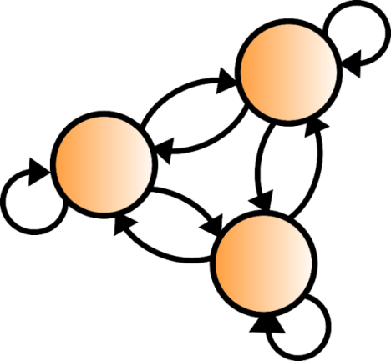
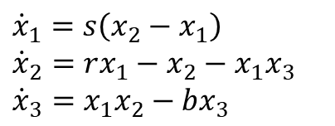
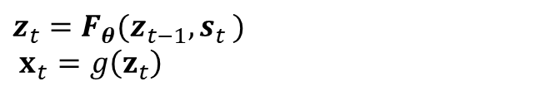
Dynamical Systems Reconstructions (DSR)
Universal approximator
Unknown DS
Generic reconstruction model
$${\dot{x}}_{1}=s\left(x_{2}−x_{1}\right)$$
$${\dot{x}}_{2}=rx_{1}−x_{2}−x_{1}x_{3}$$
$${\dot{x}}_{3}=x_{1}x_{2}−bx_{3}$$
Inference
$$z_{t}=F_{θ}(z_{t−1},s_{t })$$
$$x_{t}=g\left(z_{t}\right)$$

Slide 3


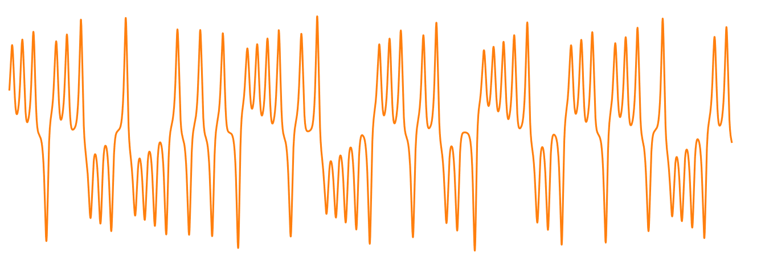
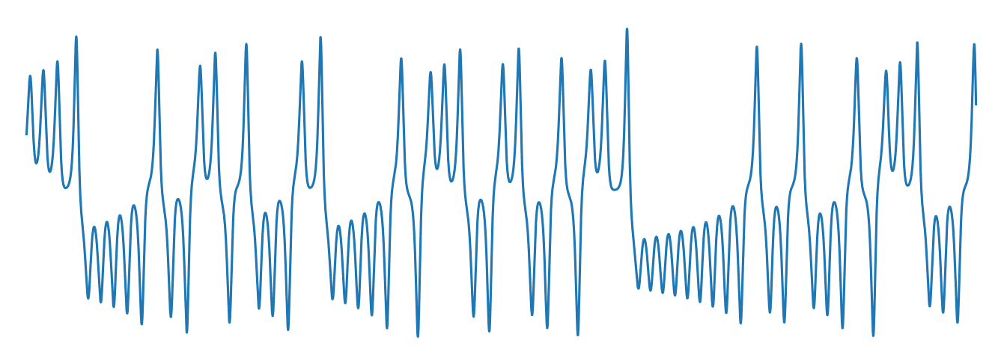
Dynamical Systems Reconstructions (DSR)
Universal approximator
Unknown DS
Generic reconstruction model
$${\dot{x}}_{1}=s\left(x_{2}−x_{1}\right)$$
$${\dot{x}}_{2}=rx_{1}−x_{2}−x_{1}x_{3}$$
$${\dot{x}}_{3}=x_{1}x_{2}−bx_{3}$$
Inference
$$z_{t}=F_{θ}(z_{t−1},s_{t })$$
$$x_{t}=g\left(z_{t}\right)$$
Observed trajectory
Simulated trajectory
Agreement in geometrical and temporal structure
Time
Time

Slide 4
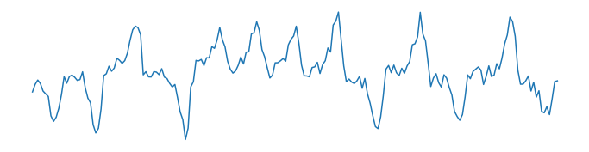
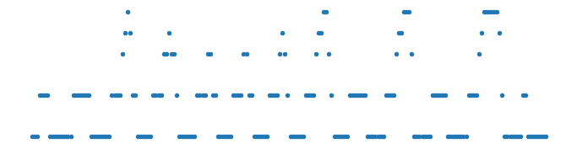
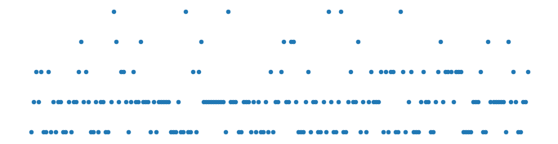
DSR from Multimodal Time Series
Measurements (psychology, neuroscience, climate science etc.)
Gaussian Obs.
continuous
Inference
Ordinal Obs.
Poisson Obs.
discrete
Time

Slide 5
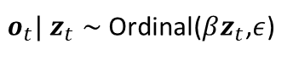

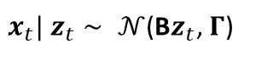


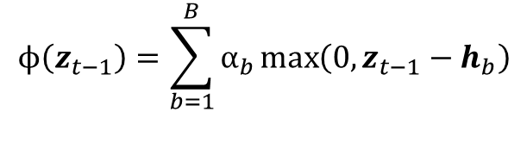

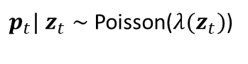
DSR from Multimodal Time Series
Measurements (psychology, neuroscience, climate science etc.)
$$z_{t−1}$$
$$z_{t}$$
$$z_{t+1}$$
Model
dendPLRNN (Brenner, Hess et al., ICML 2022)
Math. tractability
Gaussian Obs.
continuous
Inference
$$z_{t}=Az_{t−1}+Wϕ\left(z_{t−1}\right)+h$$
Ordinal Obs.
$$ϕ\left(z_{t−1}\right)=\sum_{b=1}^{B}{α_{b}}\max\left(0,z_{t−1}−h_{b}\right)$$
Different distributional assumptions
Poisson Obs.
discrete
Gaussian Obs.
Ordinal Obs.
Poisson Obs.
$x_{t}| z_{t}$ $∼ 𝒩$(B$z_{t}$, $Γ$)
$o_{t}| z_{t}$ $∼$Ordinal($βz_{t}$,$ε$)
$p_{t}| z_{t}$ $∼$Poisson($λ{(z}_{t})$)
Time

Slide 6
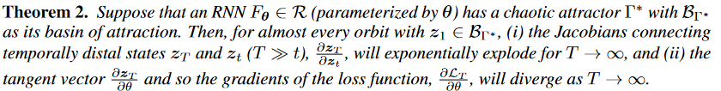
Challenges of DSR
Chaotic dynamics
Challenge
Divergent loss gradients (Mikhaeil, Monfared&Durstewitz, NeurIPS 2022)

Slide 7
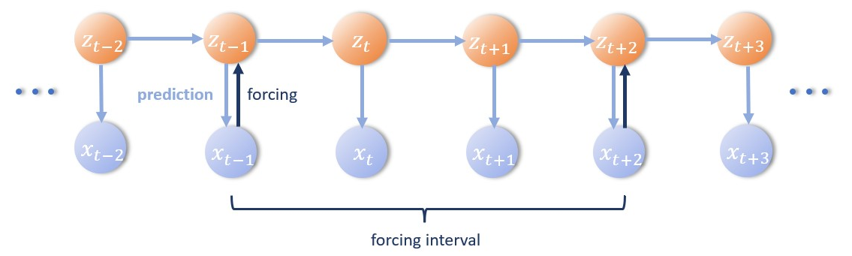
Challenges of DSR
Chaotic dynamics
Challenge
Divergent loss gradients (Mikhaeil, Monfared&Durstewitz, NeurIPS 2022)
Proposed Solution
Sparse teacher forcing (TF)
(inversion)
forcing interval →Lyap. spectrum
SOTA performance for DSR on unimodal normal data (Brenner, Hess et al., ICML 2022)

Slide 8

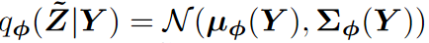
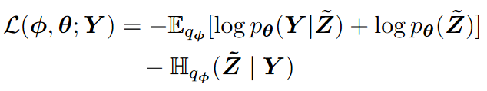
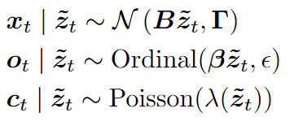
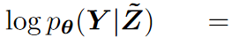
Multimodal Variational Autoencoders
Gaussian Obs.
Ordinal Obs.
Poisson Obs.
Observations
Encoder (CNN)
Approximate posterior
ELBO Loss
Decoder
Observation Models
Data Likelihoods

Slide 9
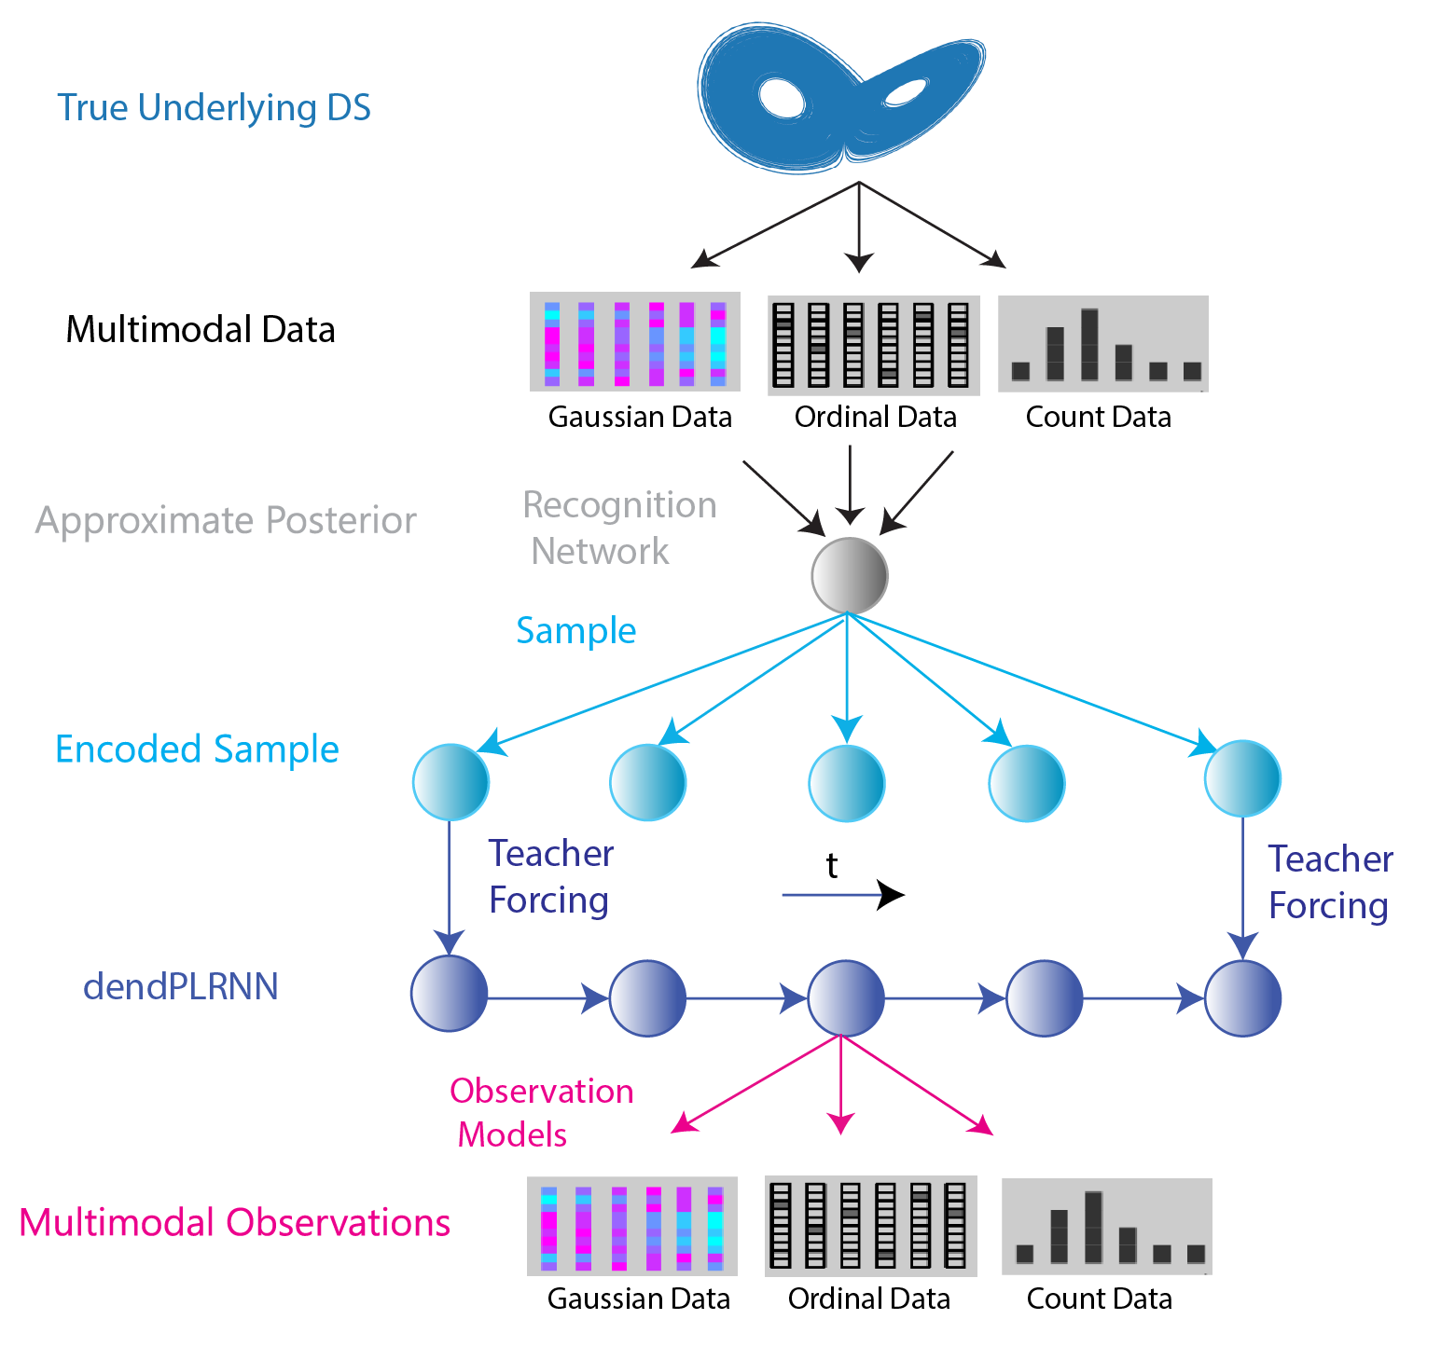
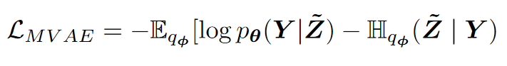
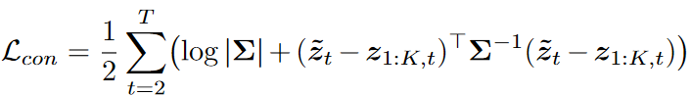
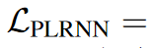
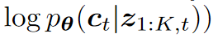
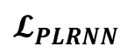
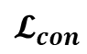

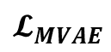
Multimodal Teacher Forcing (MVAE-TF)
$$𝓛 =𝓛_{MVAE}+𝓛_{con}+𝓛_{PLRNN}$$
MVAE Loss
$$𝓛_{MVAE}$$
Consistency Loss between MVAE and PLRNN
$$𝓛_{con}$$
Data likelihoods from PLRNN
$$𝓛_{PLRNN}$$

Slide 10
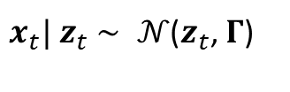
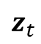
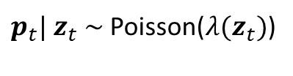
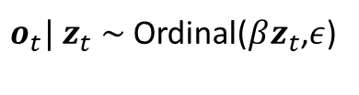
Multimodal Reconstructions
Randomly initialized obs. models
Noisy Gaussian Obs.
$x_{t}| z_{t}$ $∼ 𝒩$($z_{t}$, $Γ$)
Underlying DS
Ordinal Obs.
$o_{t}| z_{t}$ $∼$Ordinal($βz_{t}$,$ε$)
$z_{t}$
Poisson Obs.
$p_{t}| z_{t}$ $∼$Poisson($λ{(z}_{t})$)

Slide 11
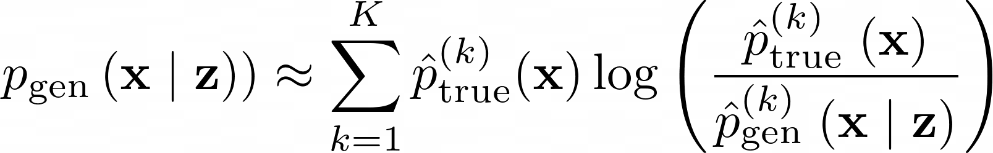
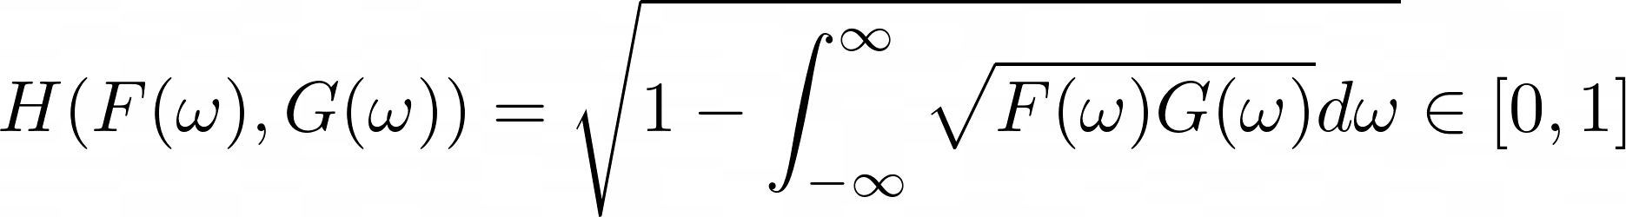
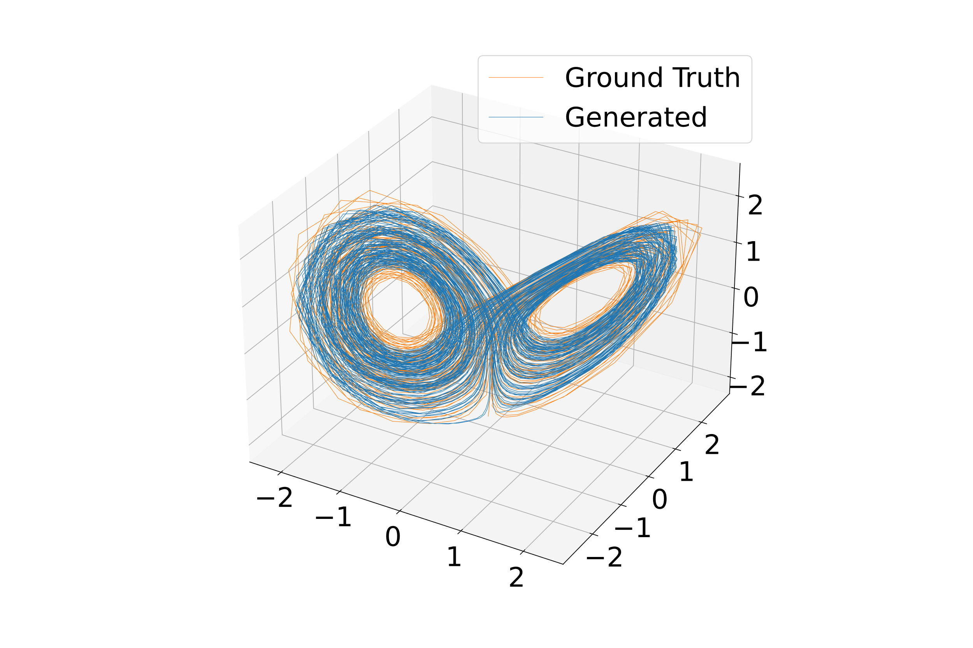
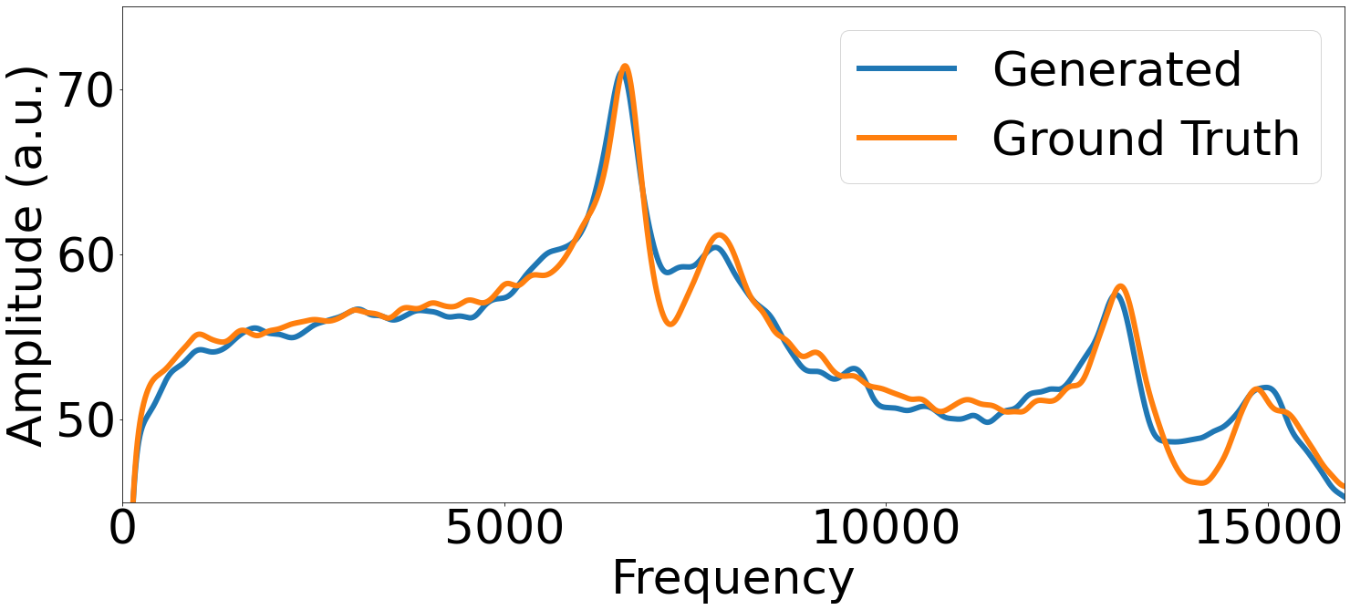
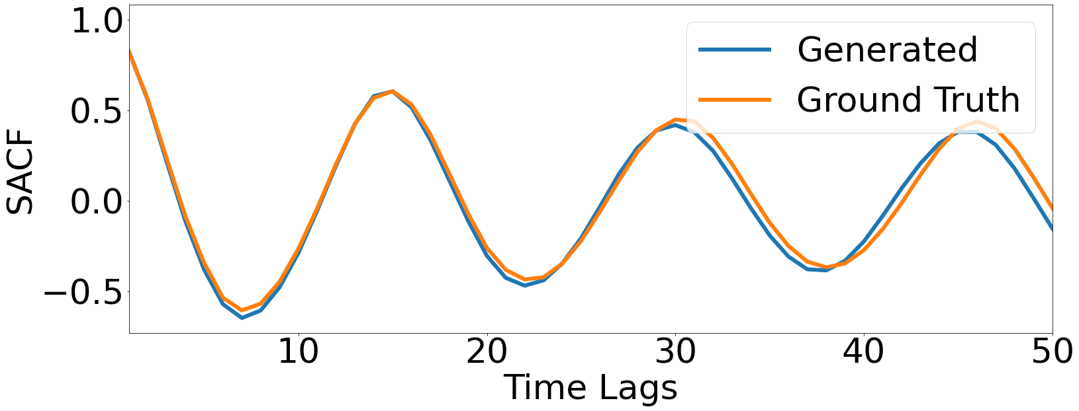
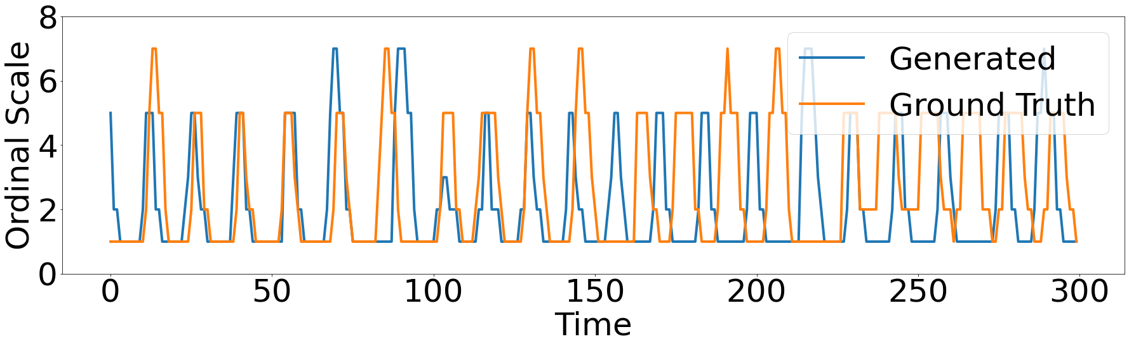
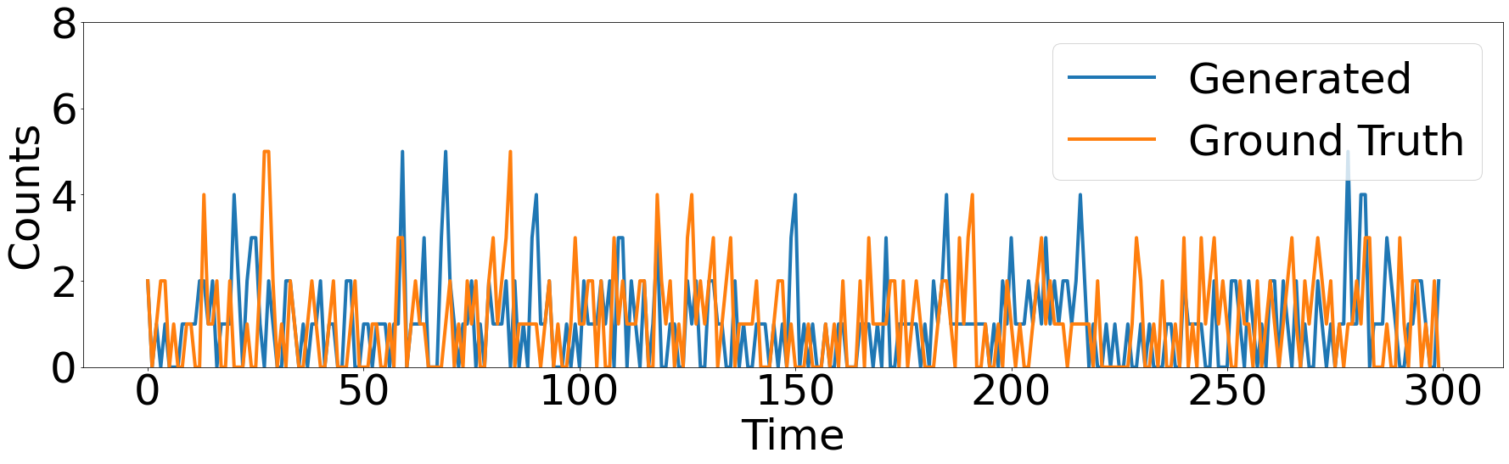
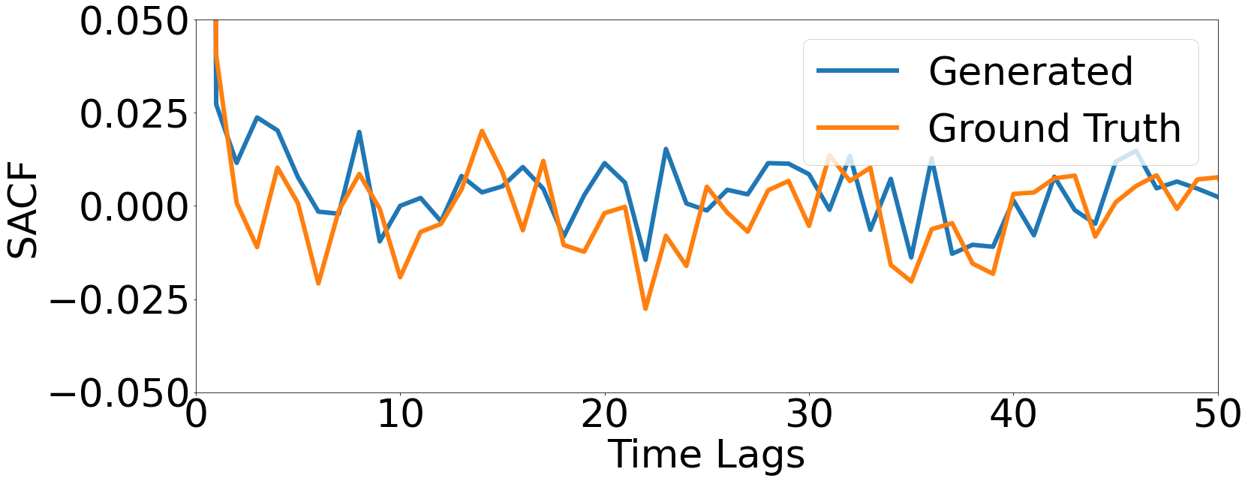
Multimodal Reconstructions
Randomly initialized obs. models
Geometric Agreement
Temporal Agreement
Noisy Gaussian Obs.
$x_{t}| z_{t}$ $∼ 𝒩$($z_{t}$, $Γ$)
Underlying DS
Ordinal Obs.
$o_{t}| z_{t}$ $∼$Ordinal($βz_{t}$,$ε$)
$z_{t}$
Poisson Obs.
$p_{t}| z_{t}$ $∼$Poisson($λ{(z}_{t})$)

Slide 12
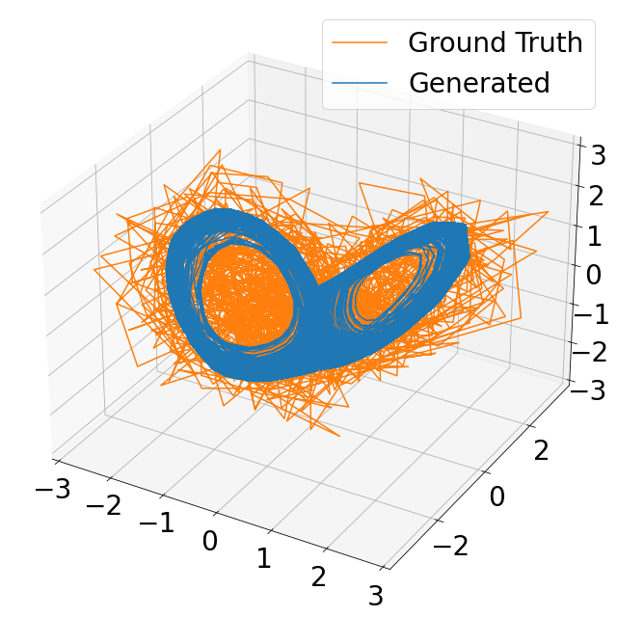

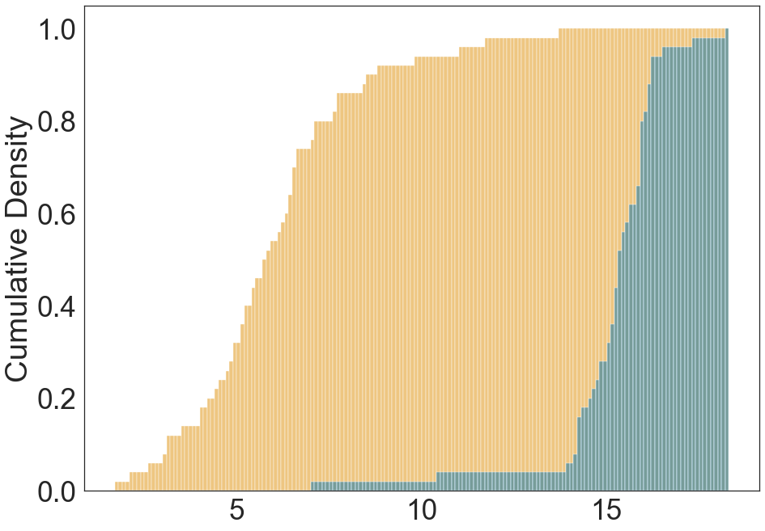

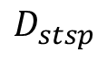
Challenging Data Settings
Reconstructed State Space
Multimodal Data Improve DSR
Gaussian
Gaussian
Gaussian +Ordinal
$$D_{stsp}$$

Slide 13
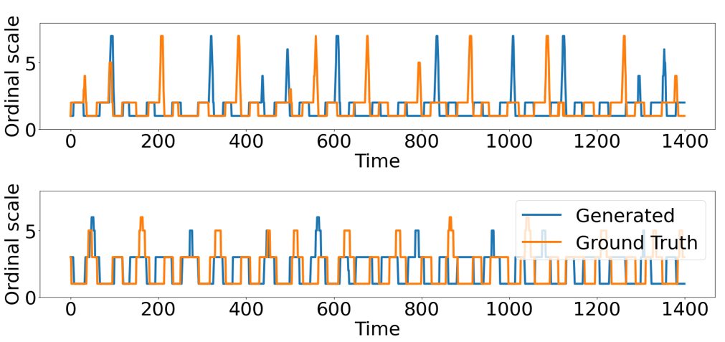
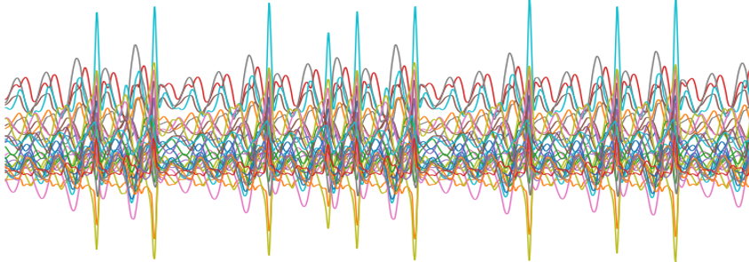
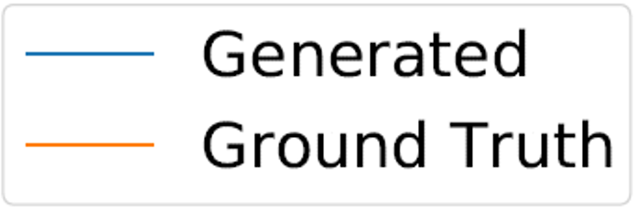
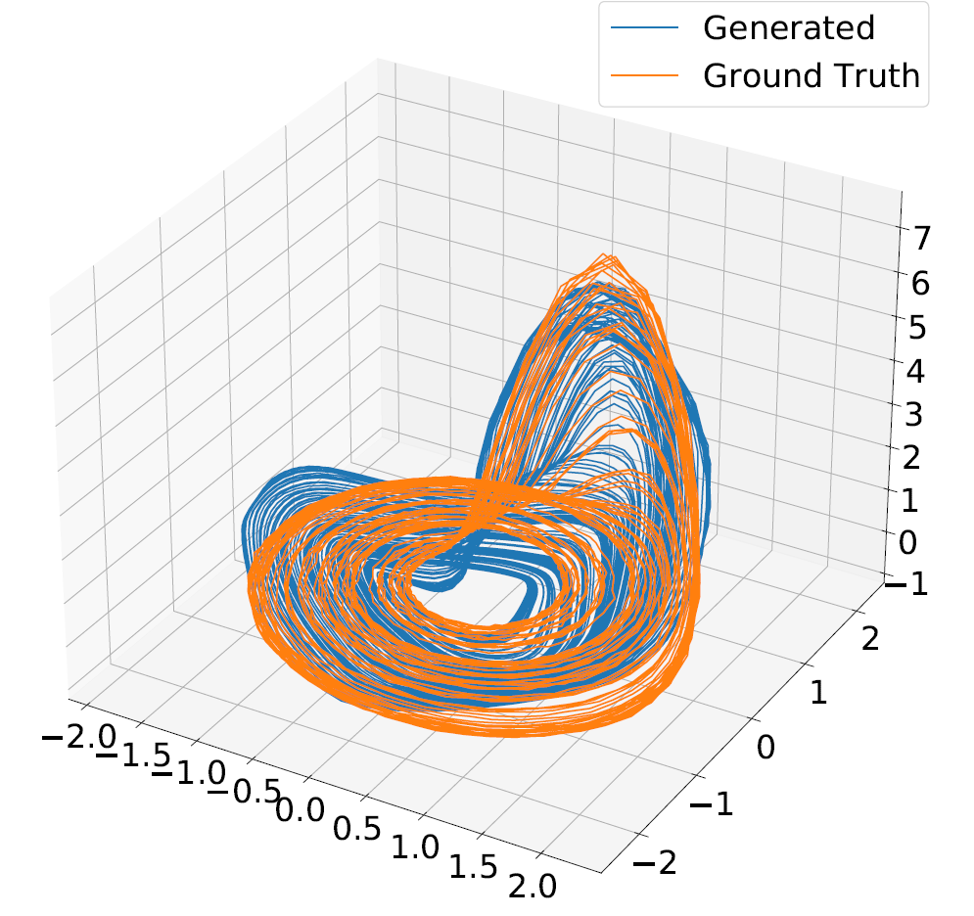
Discrete Observations&Experimental Data
Chaotic Rössler attractor from discrete ordinal observations
Train RNN model
Geometry preserving transformation

Slide 14
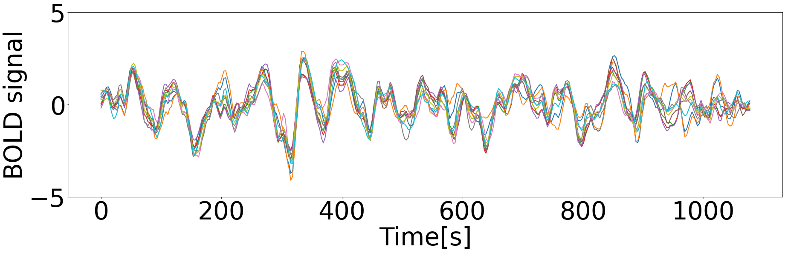
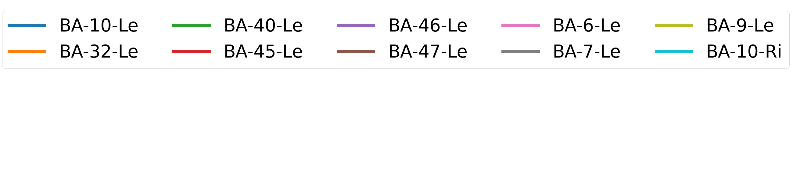
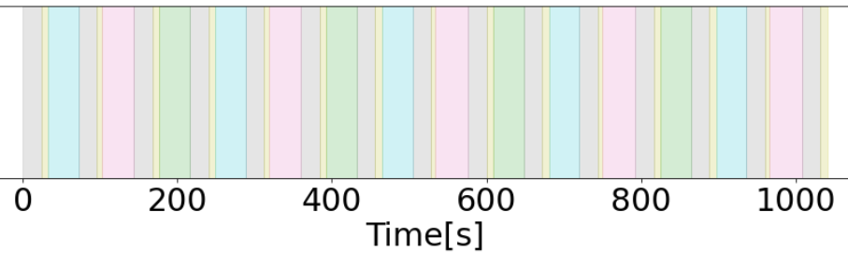
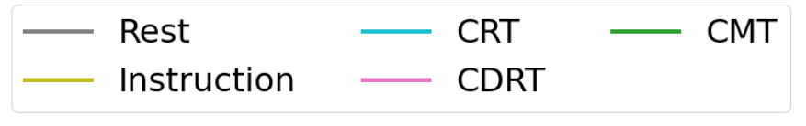


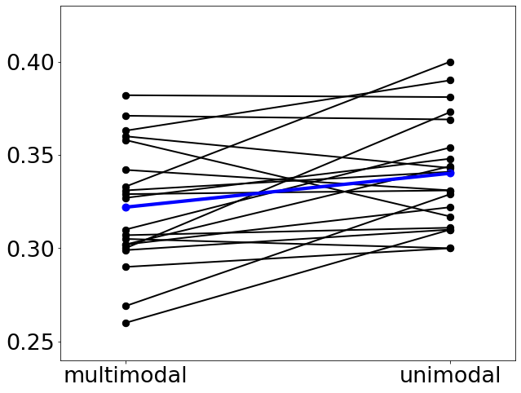







Discrete Observations&Experimental Data
Chaotic Rössler attractor from discrete ordinal observations
Neurophysiological Data+Behavioral Data
Gaussian Data
$x_{t}| z_{t}$ $∼ 𝒩$(B$z_{t}$, $Γ$)
Categorical Data
Train RNN model
$c_{t}| z_{t}$ $∼Cat$($z_{t}$,$β$)
Geometry preserving transformation
Structured latent activity
Improved DSR
$$p<.007$$
$$z_{10}$$
$$D_{H}$$
$$z_{5}$$

Slide 15


Competitive Performance
Neurophysiological Data

Slide 16





Conclusions
Reduced Dimensionality
Mathematical Tractability
Competitive Performance
Flexible training framework for DSR from multimodal time series combining sparse TF with MVAEs
DSR from highly noisy and and non-Gaussian obs. from chaotic systems
State of the art performance
on benchmark & experimental datasets
This work was funded by the European Union’s Horizon 2020 research and innovation Programme under grant agreement 945263 (IMMERSE), by the German Research Foundation (DFG) within the collaborative research center TRR-265 (project A06), and by a living lab grant by the Federal Ministry of Science, Education and Culture (MWK) of the state of Baden-Württemberg, Germany (grant number 31-7547.223-7/3/2), to DD and GK.

Slide 17
Dynamical Systems Reconstructions
Lorenz Eqns.
Generic reconstruction model
$${\dot{x}}_{1}=s\left(x_{2}−x_{1}\right)$$
$${\dot{x}}_{2}=rx_{1}−x_{2}−x_{1}x_{3}$$
$${\dot{x}}_{3}=x_{1}x_{2}−bx_{3}$$
Inference
$$z_{t}=F_{θ}(z_{t−1},s_{t })$$
$$x_{t}=g\left(z_{t}\right)$$
Agreement in geometrical and temporal structure

Slide 18


Experimental Data
Short fMRI recordings (1/3 Hz) from 20 brain regions of 26 subjects performing working memory tasks
Gaussian Data
$x_{t}| z_{t}$ $∼ 𝒩$(B$z_{t}$, $Γ$)
Categorical Data
$c_{t}| z_{t}$ $∼Cat$($z_{t}$,$β$)

Slide 19










Multimodal Data Integration
$$p<.012$$
$$p<.007$$
Improved geometrical and temporal reconstructions
$$D_{stsp}$$
$$D_{H}$$
Test set predictions with correct decoded task stages
Structured latent activity
$$z_{10}$$
$$z_{5}$$

Slide 20
DSR from Binary Ordinal Observations

